Slide 1
ACS – SDIL Deployment Team - Knowledge Transfer
Gopalakrishnan C
Aishwaryalakshmi S

Slide 2
ACS - Introduction
ACS:
ACS stands for Auto Configuration Server
Vendor : Axiros
Component owner : Roman Reiss / Heimo Pleschiutschnig
Usage:
Interact with clients or CPE’s for management , reporting, troubleshooting and firmware upgrades.
ACS have a connectivity between all the set top boxes where the customers being used. We can manage all our operations of all set top boxes using ACS application.
For example we can do reboot, upgrade your set top boxes, downgrade your set top boxes remotely and FTI (First Time Installation).
Supporting Countries:
BE - Telenet
NL - Ziggo
CH - UPC
UK - Virgin Media
CL - VTR

Slide 3
ACS - Introduction Cont..
Infrastructure for each country:
Two MySQL Database servers with 4 CPUs & 10 GB Memory
Store CPE logs and Netflix & Widewine keys
Two Northbound Application Servers with 6 CPUs & 4 GB Memory
Reporting and database cluster to store data
Two Southbound Application Servers with 4 CPUs & 6 GB Memory
Handle incoming TR-069 requests and notification server
Features:
ACS have a feature called campaigns. The campaigns used to do bulk activities.
When we are upgrading all of our set top boxes we will create a campaigns and will schedule at night. Once its done all of our set top boxes provisioned to the higher version.

Slide 4
ACS - Introduction Cont..
MQTT Service:
Mqtt service using by the customer care. When customer reports any issue in the set top box they will contact customer care.
Customer care use this service and login the set top boxes to fix the issue. For mqtt service we have different user in all the servers for all countries.
CRS:
CRS stands for CPE Redirect Service
When we are doing First Time Installation CRS will detect the GEO Graphical location automatically and download required packages based on the location from VSPP and configure the set top boxes.
As per CRS upgrade we are updating the OMW config file.

Slide 5
ACS - Deployment
Deployment Versions:
M2D3 – Greenfield.
R4.5.3 – Manual Table Creation & Key import.
R4.6 – Some manual activities.
R4.7 – Automatic Table Creation & User Creation. Prechecks are automated
R4.8 – Changed chroot path. Replaced MySQL proxy LB to advanced HA proxy LB. Upgraded MySQL & ACS Application version.
R4.9 - Small patch from development side.
R4.10 – Fstab fix
R4.12 – STB Provisioning
R4.13 – Changes in CPE ID & Cleanup activities
R4.15 - Cleanup activities & OMW file update
Deployment Timings:
PreProd - All five countries (BE,NL,CH,UK,CL) in same day 6 AM to 11:30 AM CET
Prod - Four Countries (BE,NL,CH,UK) in same day 1 AM to 6AM CET
- CL (VTR) in Next day 7 AM to 12 PM CET

Slide 6
ACS - Application Workflow
ACS Development Team
Develop the code based on the requirement.
Lab OBOSI Team
Lab team doing code evaluation, syntax issues, compilation issues and also they test only one application.
E2ESI Team (5A Lab)
E2ESI team is doing the integration testing for all of our components.
Also they verify all the user stories are functionally working.
PreProd Deployment
SDIL Deployment team doing preprod and prod deployment.
Prod Deployment
Note:
Lab OBOSI & E2ESI Team handled by Accenture.
PreProd & Prod Deployment handled by us (Prodapt).

Slide 7
ACS - Deployment Process Flow
Below process we are following for all the deployments.
Access to the servers (PreProd/Prod)
VPN Access
Jump Servers Access
ACS Servers
Temp Sudo Access
Prepare Application LLD
We need to verify all the variables and attributes in the ansible deployment playbook with acs-obo.ini file based on the deployment guide.
Verify the servers list and IP addresses with help of Infra LLD for all countries.
Update the new variables & attributes in acs-obo.ini file.
Once acs-obo.ini file updated we need to get an approval from E2ESI team in LG. The acs-obo.ini file should be approved before deployment. We have Jira ticket for this. We need to attach the file and send the ticket to particular person.
Create CRQs for all release.

Slide 8
ACS - Deployment Process Flow Cont..
Prerequisites for all countries
Connection Status based on Network LLDs.
All the binaries are in place.
All the deployment related Playbooks, Jenkins Pipeline jobs, Variables, Vault file.
Take Jira tickets on your name and create subtasks based on the Runbook.
Snapshot ticket should be created and send to Ashok.
Verify all the services are up and running for all servers. And verify DB replication happening correctly.
Verify ACS GUI is working properly before upgrade.
Deployment/Upgrade
Run the Jenkins pipeline job with parameters.
Sanity Check
After upgrade verify all the services are up and running.
Verify DB replication happening correctly.
Verify all ACS GUI is working properly after upgrade.

Slide 9
ACS - Deployment Process Flow Cont..
TAF Job Execution
We need to run TAF jobs in Jenkins
Update the test results in Jira tickets.
Handover the Application to E2ESI team.
E2ESI team validate the functional changes of latest release.
Point of Contacts:
Application LLD Approvals: will be used to share the NBI user name and password and Application LLD approvals
BE → Misic Krunoslav (krunoslav.misic@telenetgroup.be)
NL,CH,CL,UK → Piotr Kakol (lpereira.contractor@libertyglobal.com)
ACS Lab/E2ESI Team: used for deployment handovers
Mecetins, Mihails (mihails.mecetins@accenture.com)
Sateesh Karunanidhi (s.c.karunanidhi@accenture.com)
ACS Development team: ACS Vendor from Development team
Adelmann, Martin (madelmann@libertyglobal.com)
ACS Key Import: used for Netflix and Widevine key import in ACS MySQL database
Reiss, Roman (rreiss@libertyglobal.com)
ACS Support Group: Used for Escalations and support in case of Roman and Martin Absence
Liberty Global-ACSSupport (ACSSupport@libertyglobal.com)

Slide 10
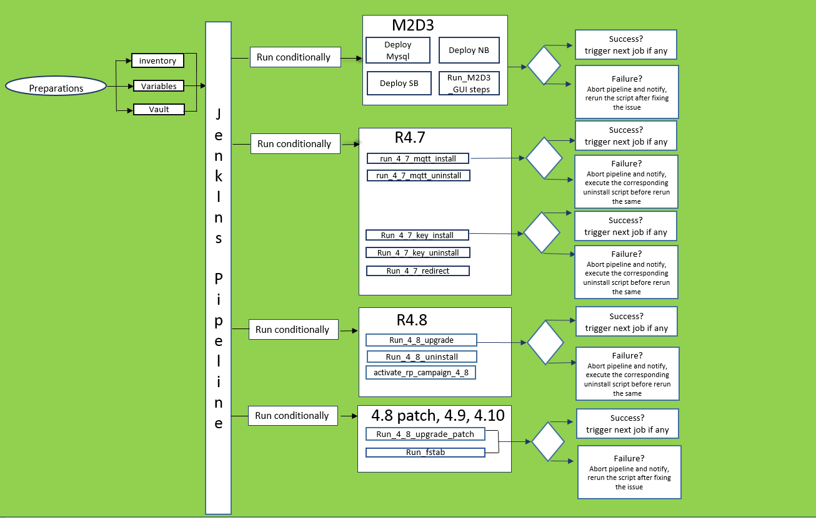
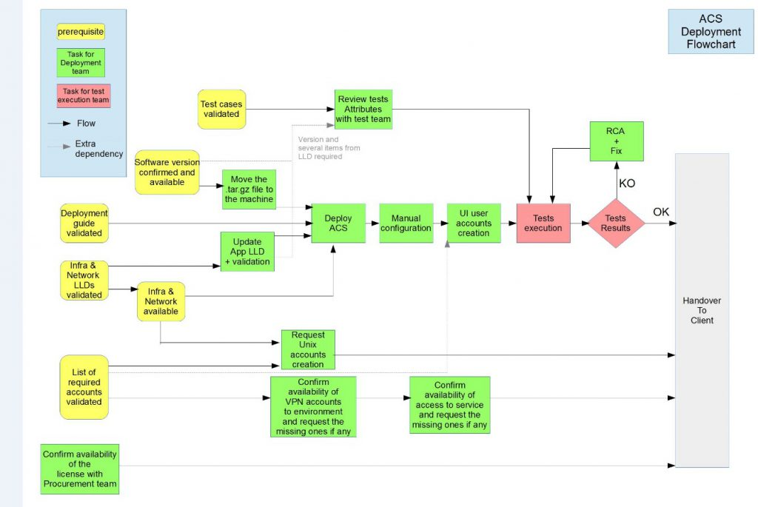
Deployment Stages

Slide 11
Start/Stop/Status Procedure
Start MySQL service in both the DB Nodes :
# sudo /usr/sbin/chroot /app/opt/production_mysql_38 /etc/init.d/mysql start
Start axess_all_daemons service in all the NB/SB Nodes:
# sudo /usr/sbin/chroot /app/opt/production_mysql_38 /etc/init.d/axess_all_daemons start
Stop axess_all_daemons service in all the NB/SB Nodes:
# sudo /usr/sbin/chroot /app/opt/production_mysql_38 /etc/init.d/axess_all_daemons stop
Stop mysql service in both the DB Nodes :
# sudo /usr/sbin/chroot /app/opt/production_mysql_38 /etc/init.d/mysql stop
Status axess_all_daemons service in all the NB/SB Nodes:
# sudo /usr/sbin/chroot /app/opt/production_mysql_38 /etc/init.d/axess_all_daemons status
Status mysql service in both the DB Nodes :
# sudo /usr/sbin/chroot /app/opt/production_mysql_38 /etc/init.d/mysql status

Slide 12
DB Replication Procedure
Run the below commands to check the DB Replication manually.
DB01:
# sudo /usr/sbin/chroot /app/opt/production_mysql_38/
# mysql
$ use dawn;
$ insert into AXServiceLogTable(id,ts,logLevel,state,log) values(100,999,9,0,'firstToSecond’);
DB02:
# sudo /usr/sbin/chroot /app/opt/production_mysql_38/
# mysql
$ use dawn;
$ insert into AXServiceLogTable(id,ts,logLevel,state,log) values(100,999,9,0,'secondToFirst’);
Both DB01 & DB02:
$ select count(*) from AXServiceLogTable where log in('firstToSecond','secondToFirst’);
DB01:
$ delete from AXServiceLogTable where log="firstToSecond";
DB02:
$ delete from AXServiceLogTable where log="secondToFirst";
Both DB01 & DB02:
$ select count(*) from AXServiceLogTable where log in('firstToSecond','secondToFirst');

Slide 13
ACS GUI
To connect ACS GUI, we need follow below tunneling process.
Connect to the mobaxterm and run below commands for each server.
ssh -L 9090:localhost:9090 username@172.23.100.15 → Jump host
ssh -L 9090:localhost:443 username@10.95.101.109 → Management IP
Go to browser then give this entry for ACS GUI home page.
https://localhost:9090/dawn/manage
We have prepared the script for tunneling process to verify ACS GUI.

Slide 14
Important URLs
Jenkins URL:
http://172.23.27.249:8080/
Nexus URL:
http://172.23.27.252:8081
Binaries in Nexus Server:
http://172.23.27.252:8081/#browse/browse/assets:axiros
Ansible Server:
172.23.27.231
Infra & Network LLDs:
https://bitbucket.upc.biz/projects/COS/repos/oboarchitecture/browse
Jenkins Pipeline Groovy Script:
https://bitbucket.upc.biz/projects/COS/repos/oboaxirosautomation/browse/pipeline/stages/Deployment
Ansible Deployment Playbooks:
https://bitbucket.upc.biz/projects/COS/repos/oboaxirosautomation/browse/scripts/deploymentScripts/ansible
PreDeployment Jenkins Jobs:
http://172.23.27.249:8080/job/99.OBO_Development/job/_old_archived/job/ACS_PreDeployment
Deployment/Upgrade Jenkins Jobs:
http://172.23.27.249:8080/job/02.OBO_Application_Deployment/job/Axiros/job/Pipeline_as_code/
TAF job execution:
http://172.23.27.249:8080/job/05.OBO_Application_Verification/job/ACS_MultiSetup_App_Deploy_Verification/

Slide 15
Access Details
Below accesses we need to raise for new joiners
UIM account access
VPN access[lab/prod]
Service Access in UIM
CNT-CIO-DC-MGT-GREEN : To access production instances from jump hosts
CNT-ECX-JUMPHOSTS : access Jump Hosts
CNTLABS-LGI-Users
Jump servers access
Crowd access
Wiki access
Jira access
Bitbucket access
Host Access - We need to raise host access for all PreProd & Production ACS servers. We can raise the access via bundles or we can raise individual server access.
Jenkins URL access

